Slide 1
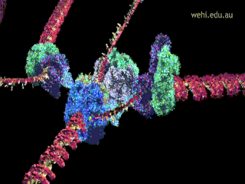
DNA replication
ATHBY Human Biology

Slide 2
Review
Sketch graphs for enzyme function at different
Substrate concentration
Enzyme concentration
Temperature
pH (4 marks)
2. Which structures are involved in synthesis of enzymes? Explain. (4 marks)

Slide 3
Review
List the types of proteins found in the cell membrane (fluid mosaic model) and explain the function of each in this location. (6 marks).

Slide 4
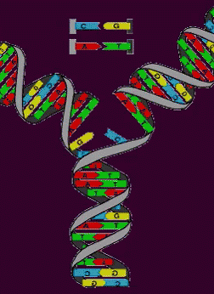
Learning Intentions
The structural properties of the helical DNA molecule, including double-stranded, nucleotide composition and weak bonds involved in base pairing between the complementary strands, allow for its replication

Slide 5
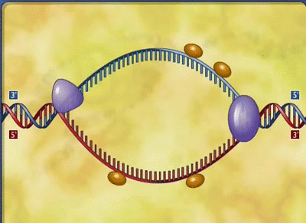
Success criteria
Describe the process of DNA replication.
Describe the role of helicase, DNA primase, DNA polymerase and DNA ligase.
Describe DNA replication as occurring from 5’to 3’.

Slide 6
Make a table
Enzyme | ‘Nickname’ | Role in DNA synthesis
helicase
DNA primase
DNA ligase
DNA polymerase

Slide 7
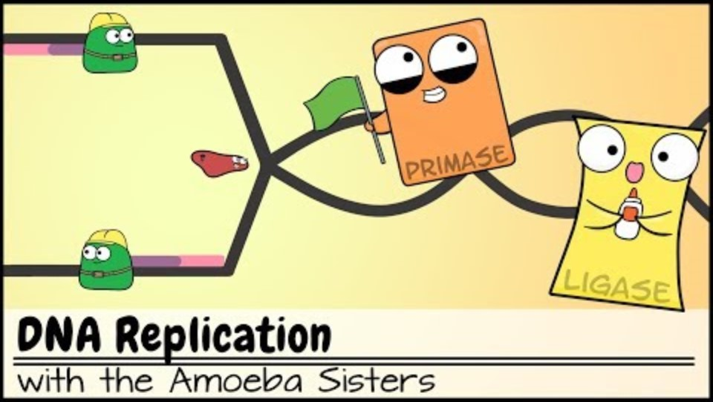

Slide 9
BioMan Biology

Slide 10
Questions
Where is DNA located within the cell?
Draw a labelled diagram of a nucleotide, showing the 5’and 3’.
Name the four nitrogenous bases found in DNA.
Which type of bonds hold the nitrogenous base complementary pairs together? Is this bond stronger or weaker than the bond between the carbons in the sugar and phosphates?
Outline the steps of DNA replication.

Slide 11
Success criteria
Describe the process of DNA replication.
Describe the role of helicase, DNA primase, DNA polymerase and DNA ligase.
Describe DNA replication as occurring from 5’to 3’.

